Slide 1

Discrete Probability
Ricardo Fernandez
CS 131; Spring 2021

Slide 2
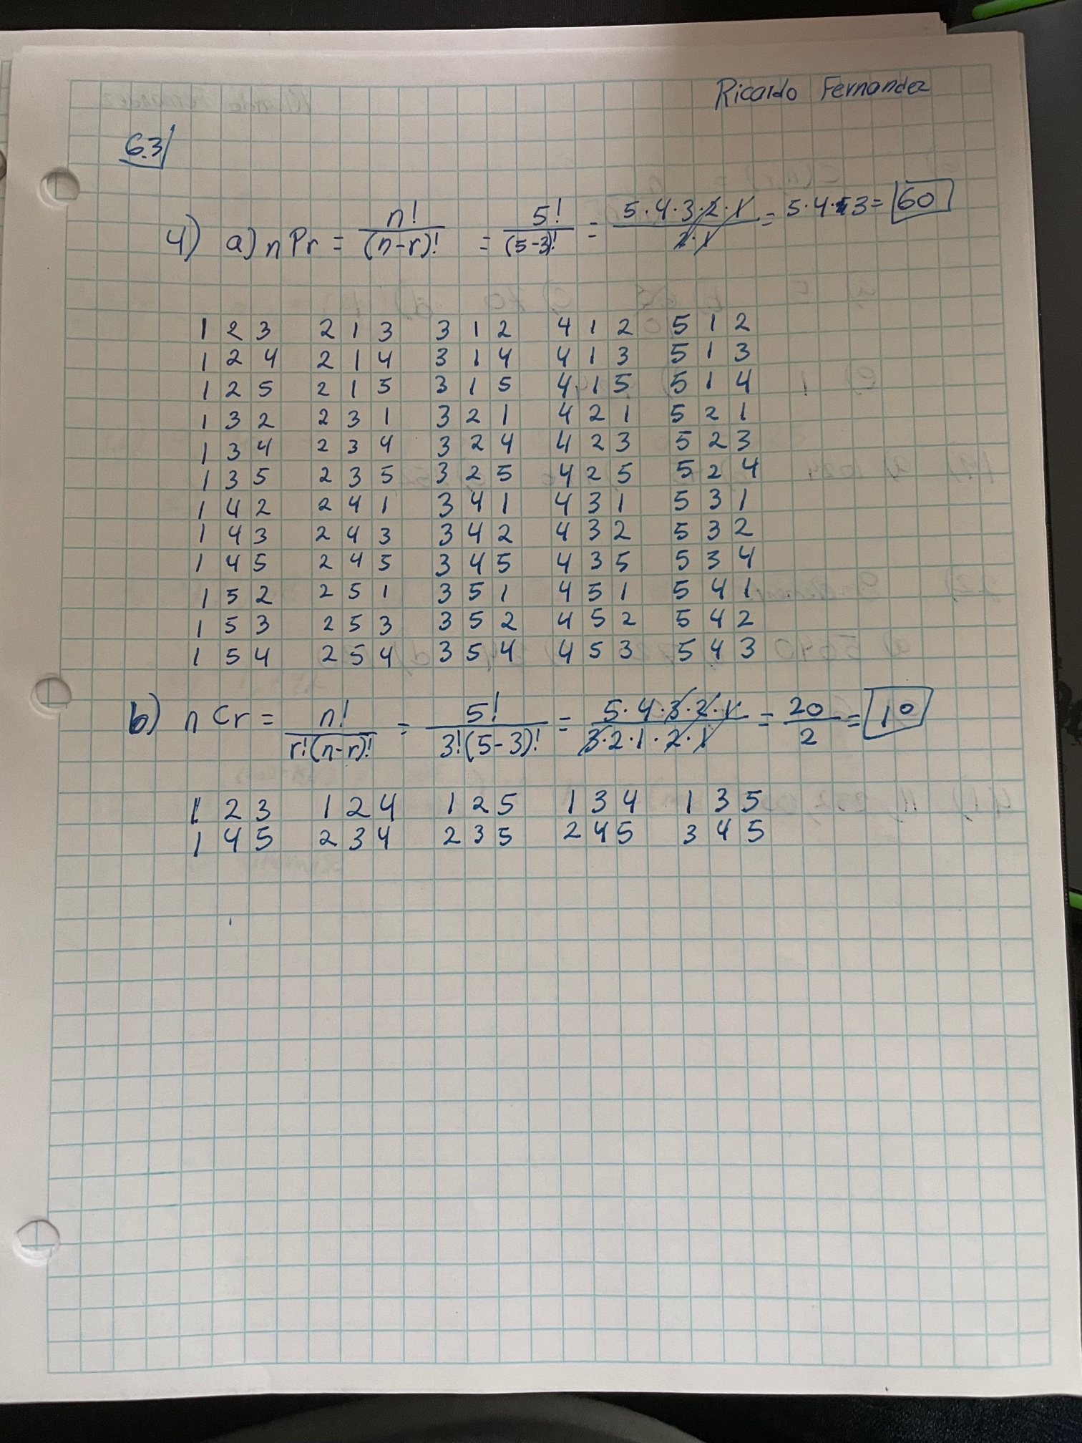
Why do we care?
Writing out these problems can be very time consuming when doing it by hand.
Our intuition might not as accurate as we like.

Slide 3

Probability of a desired dice roll

Slide 4
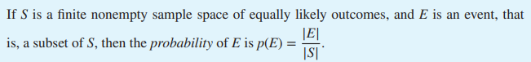
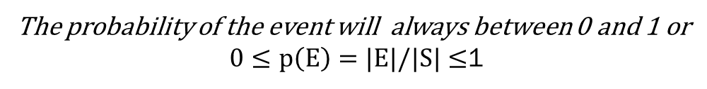
Finite Probability
E in this case will be the desired event
S is the set of all possible outcomes
The probability of the event will always between 0 and 1 or
$0≤p\left(E\right)=|E|/|S|≤$1

Slide 5
Modeling
The Dice
The number of dice
Desired Roll
Sample Space
Event Space

Slide 6

Implementation
Itertools Python library
Calculate Sample Space List
For Loop
Check the Sample Space for desired events and append them to an event space list
Probability Formula
Calculate the probability of the event given the sample space

Slide 7
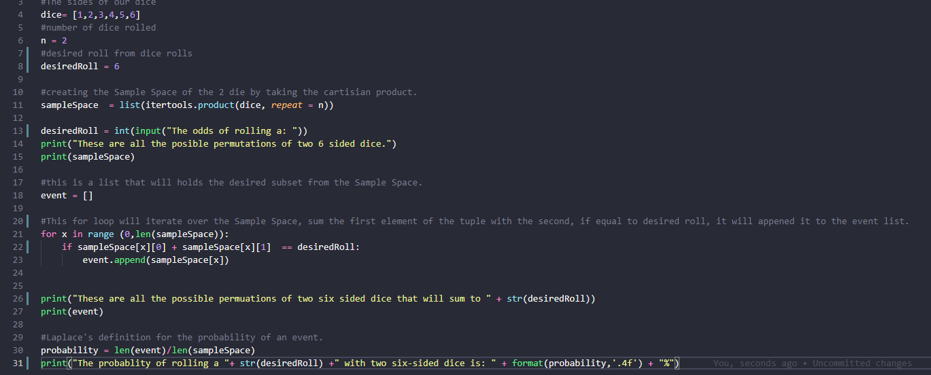
The Code

Slide 8

The Output

Slide 9
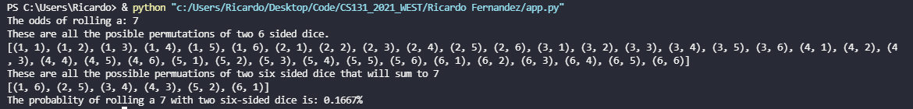
The Most Probable roll

Slide 10
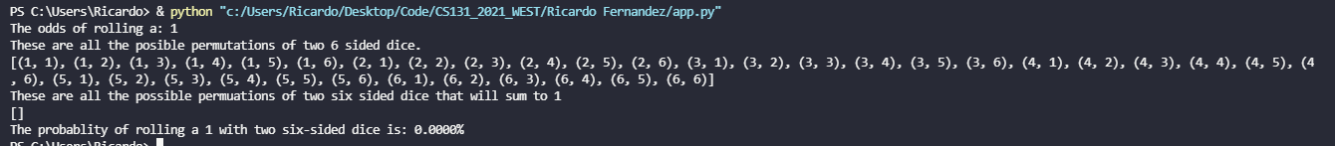
An Impossible Roll

Slide 11
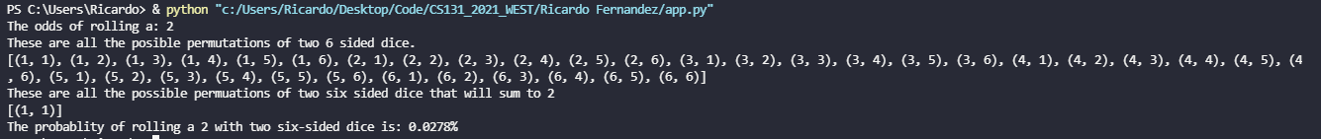
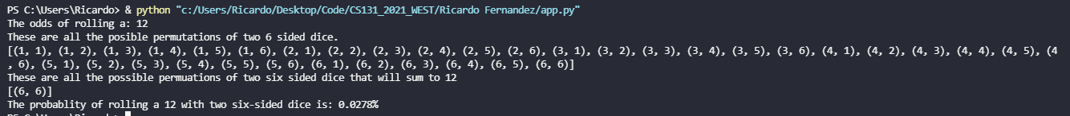
Your Lucky Day

Slide 12
The Distribution

Slide 13

Conclusion
Understanding of Finite Probability can allow us to model real life and help us understand how likely an even is to occur.
In conjunction with simple code, we can generate a sample and event space in seconds allowing us to calculate probable events.
7 really isn’t that lucky

